Slide 1

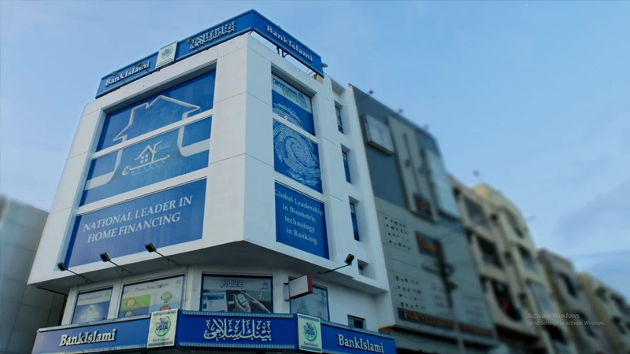
Branch Manager:-
Khurram Muhammad Javed Durrani
Group 3 Presentation
Group Members:-
Hamza Khan
Muneeb Ahmed
Ehsan Saleem
Farooq Umer
Junaid Saeed

Slide 2
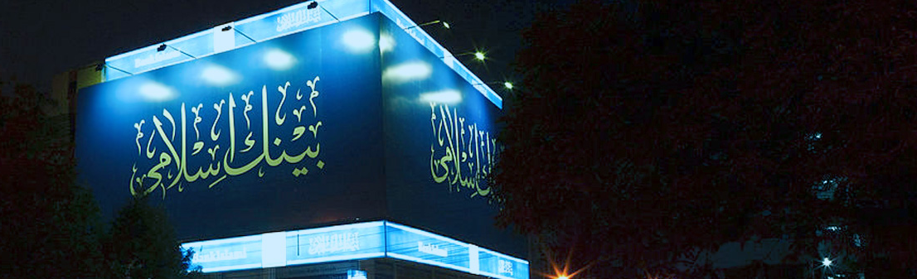
1
Introduction

Slide 3
Introduction
Islamic Banking Principles:
Innovative Shariah Compliant Products:
Customer Centric Approach:
Bank Islami is a financial institution dedicated to operating in accordance with Shariah principles. It offers a range of banking services while strictly adhering to Islamic teachings, which prohibit the collection or payment of interest (riba),
Innovative Shariah-Compliant Products: Bank Islami is known for its innovative range of Shariah-compliant financial products and services.
With a focus on providing ethical and inclusive financial solutions, Bank Islami prioritizes its customers' financial well-being.

Slide 4
2
Management

Slide 5
Management Levels & their Roles
President/CEO
Regional Manager
Area Manager
Non Managerial Employees
Operation Manager
Branch Manager

Slide 6
Managerial Skills
Technical Skills:-
Human Skills:-
These are specific, job-related skills. In a bank, technical skills might include knowledge of financial analysis, banking regulations, and software tools for financial management.
Human skills involve interpersonal abilities. Bank managers need these skills to work effectively with their teams and clients, fostering teamwork and resolving conflicts.
Conceptual Skills:-
Negociation Skills:-
Conceptual skills relate to a manager's ability to think strategically and see the big picture. In a bank, this could mean understanding market trends, long-term financial planning, and the bank's overall strategy.
in order to make contact with client , they have to use there negociation skills to undertand the client needs and also accomplise there goals

Slide 7
3
Ethics and WorkForce

Slide 8
Ethics
Ethics Training
Ethics training programs are invaluable tools for organizations aiming to enhance ethical behavior. These programs educate employees about ethical principles, company policies, and the consequences of unethical actions. Through interactive training sessions, employees gain a deep understanding of ethical dilemmas and learn how to navigate them responsibly.

Slide 9
s
Workforce and learning Enviroment
Workforce diversity
Continuously learning
These are specific, job-related skills. In a bank, technical skills might include knowledge of financial analysis, banking regulations, and software tools for financial management.
Human skills involve interpersonal abilities. Bank managers need these skills to work effectively with their teams and clients, fostering teamwork and resolving conflicts.

Slide 10
4
Culture

Slide 11

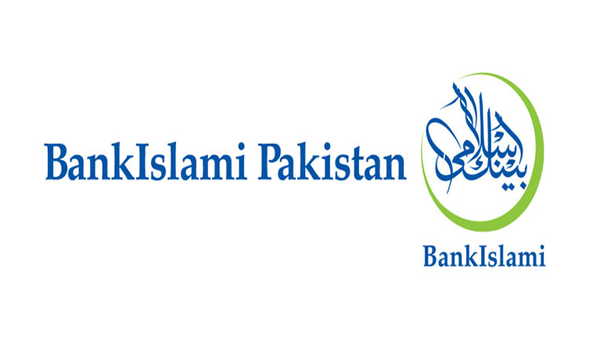
Bankislami Culture
1
Practices and Rituals
2
Stories
3
Recruitment and Socialization
4
Higher Performances

Slide 12

Gender diversity
10%
90%
Female
Male
Note: this is the approximate analysis of the gender ratio of the bankislami branches we visited

Slide 13
5
Stake holders, Stock holders, Share holders

Slide 14
Stake holders, Stock holders, Share holders
Stake holders
Stock holders
Share holders
The employees of bank islami are very essential stakeholders. By giving them a supportive work environment they can seek job security, fair compensation, career growth opportunities, and a supportive work environment. and Supliers are those who are providing services to Bank Islami. They are concerned about payment terms, timely settlements, and the bank's financial stability etc.
The stockholders have their understanding their motivation and expectations.The are very concerned about bank performance. They can get a good return through dividends and capital gains.
The shareholders of bankislami are those who are interested in bank stocks for their financial interests. They gain capital based on bankislami performance.They also have a right to vote in bank decision making process. If shareholder have a strong analysis based on their experience they can get a good return.

Slide 15
Corporate Social Responsibility(CSR):
The initiative of Bank Islami also involves assessing the bank's efforts to contribute to society, support sustainability, and operate ethically.
Focus area:-
The organization should involve the specific focus area of the bank ‘s CSR initiatives. This could include education, healthcare, community development, environmental sustainability, or other social and environmental issues.
Impact measurement:-
Assess the impact of Bank Islami's CSR activities Does they are able to measure the social, environmental, and economic outcomes of their initiatives?
Stakeholder engagement:
The stakeholder input is very important for identifying issues and concerns. Consider how the bank engages with various stakeholders, including employees, customers, local communities, and regulatory bodies, to shape its CSR strategies
Legal Requirements:
Check the legal requirements that bank islami can fullfil related to CSR in Pakistan.
Partnerships and Collaborations:
To enhance the impact and impact and reach of their CSR initiatives. The bank islami should collaborates with other organizations, NGOs, or government agencies etc.
Long-Term Commitment:
For lasting positive impacts the bank islami should Evaluate the long-term commitment of Bank Islami to CSR.

Slide 16
6
Decision Making
Process

Slide 17
In BankIslami, where adherence to Islamic principles is paramount, intuition plays a crucial role in decision-making for a Branch Manager.
How Intuition Works in Bank Islami
Values or Ethics-based Decisions
Subconscious Mental Processing
Cognitive-based Decisions
Experience-based Decisions
Affect-initiated Decisions

Slide 18
Type of Desicions for certain Problems
Structured problems
Unstructured problems

Slide 19
7
Goals & Plans

Slide 20
Types of Goals
Financial Goals: Related to internal financial performance, such as revenue targets and cost management.
Strategic Goals: Relate to the organization's performance concerning external factors like competition, market trends, and industry positioning.
Types of Plans
Strategic Plans: Apply to the entire organization, setting overarching goals and positioning strategies for extended periods.
Operational Plans: Detail specific actions to achieve strategic goals within shorter time frames, typically one year or less.
Specific Plans: Clearly defined plans, leaving no room for interpretation, ensuring precise execution.
Directional Plans: Flexible guidelines that provide focus while allowing discretion in implementation.
Single-Use Plans: Unique plans tailored for specific, one-time situations or projects.
Standing Plans: Ongoing plans guiding recurring activities, ensuring consistency and efficiency.
Traditional Goal Setting: Establishes goals at the top level, which may lose clarity and focus as they cascade down to subgoals.

Slide 21
8
PESTEL Analysis

Slide 22
PESTEL Analysis
Political Factors
Economic Factors:
Social Factors:
Changes in government policies related to the financial sector, taxation, and foreign exchange affect the bank's performance.
The overall economic growth of Pakistan influences the demand for banking services. A growing economy may lead to increased banking activities Changes in interest rates affect the bank's profitability
Population demographics, such as age distribution,race,marital status and income levels, impact the demand for various banking products and services.
Technological Factors
Environmental Factors
Legal Factors:
The level of technological adoption and innovation in the banking industry can impact Bank Islami's competitiveness. Embracing digital platforms and technology is crucial in the modern banking landscape.
Environmental concerns and sustainability are becoming more critical. Bank Islami may need to consider green banking practices and initiatives to align with global and local environmental expectations.
Compliance with consumer protection laws is essential to maintain customer trust and avoid legal issues.

Slide 23
9
Porter Analysis

Slide 24
Porter Analysis
Threat of New Entrants
Bargaining Power of Buyers (Customers)
Bargaining Power of Suppliers
Changes in government policies related to the financial sector, taxation, and foreign exchange affect the bank's performance.
Factors such as interest rates influence customers' choices.Bank Islami is free of interest system, follows Islamic shariah.
Suppliers refer to sources of funds. Mudharabah (profit sharing), Wadiah (safekeeping), Murabahah (cost plus finance),Takaful (Islamic insurance) and Sukuk (Islamic bonds).
Threat of Substitute Products or Services
Intensity of Competitive Rivalry:
The level of technological adoption and innovation in the banking industry can impact Bank Islami's competitiveness. Embracing digital platforms and technology is crucial in the modern banking landscape.
Usually The banking sector in Pakistan is highly competitive with numerous players.Ratio of Islamic Banks to Conventional Banks Is : 15%-85%

Slide 25
10
Swot Analysis

Slide 26
strengths:
Islamic Banking Principles: Bank Islami operates based on Sharia-compliant principles, attracting customers who prefer Islamic banking services.
Diverse Product Portfolio: Offering services like Murabaha, Musharakah, and Ijarah, allows the bank to cater to various financial needs
Technology Integration: One-Touch Banking System(OTBS) , All your needs are one click away.
Weaknesses:
Limited Geographic Presence: Bank Islami operates in a limited geographic area, Also only 15% Islamic banks are in Pakistan as compared to conventional banks.
Customer Perception: Some potential customers may be hesitant to adopt Islamic banking practices due to a lack of understanding or misconceptions about Islamic finance.
Opportunities:
Growing Islamic Finance Market: The increasing popularity of Islamic finance globally presents an opportunity for Bank Islami to expand its customer base.
Financial Inclusion: reaching unbanked populations and providing them with Islamic financial services.
Technological Advancements: digital banking and innovative technologies enhance customer experience and provide a competitive edge.
Partnerships and Collaborations: Collaborating with other financial institutions, businesses, or fintech companies can open up new avenues for growth and innovation.
Threats:
Technological Advancement: Apps like Easypaisa,Jazzcash etc. are a major threat to every bank aswell as bank islami.
Economic Uncertainty: Economic downturns or financial crises can negatively impact bank islami.
Cybersecurity Risks: threat of cybersecurity breaches and data theft is a constant concern that requires continuous investment in security measures.

Slide 27

THANK YOU
FOR YOUR LISTENING

